Slide 1


Java’s Blackjack
and
21 on hand
*OFFICIAL SPONSOR OF THE WEBINAR IS

Slide 2



About me: Ischenko Nikolai
17
🎭 Department manager, dev. lead
👨‍💻 In IT > 16 years
☕ With Java > 10 years
🤖 Crazy developer (hobby)
21
🎤 Speaker

Slide 3

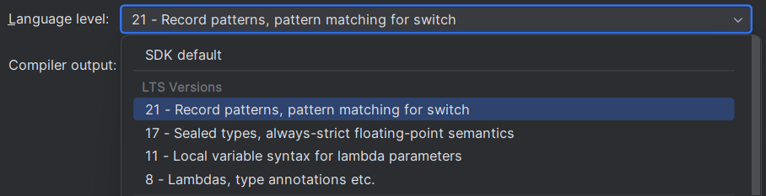
Why and Wat LTS?

Slide 4
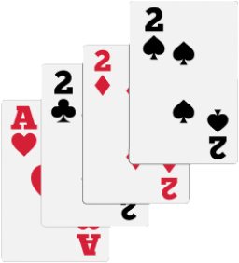
Why do we use Java 17 ?
* Released: 09/14/21
🙅 Java 11 isn’t supported yet (Ended in Sep.2023)
⛑️ RedHat OpenJDK is supported till October 2024
🍃 Spring Boot 3 (Spring 6) requires it
🤑 Oracle No-Fee Terms and Conditions [NFTC]
🆕 New Old features
Notes:
git checkout main
Java 11 isn’t supported yet
New Java 17 JEPs since Java 11: https://openjdk.org/projects/jdk/17/jeps-since-jdk-11
Extended support of Java 11 by Oracle: Oracle Releases Java 21 and Extends Support Roadmap
RedHat OpenJDK support: OpenJDK Life Cycle and Support Policy - Red Hat Customer Portal
Spring boot 3
Java trends for 2024: https://www.linkedin.com/posts/coherent-solutions_java-trends-2024-activity-7152589820177833985-IunG?utm_source=share&utm_medium=member_desktop
Spring docs: https://spring.io/blog/2022/11/16/spring-framework-6-0-goes-ga
NFTC
Oracle Java SE Licensing FAQ: https://www.oracle.com/cis/java/technologies/javase/jdk-faqs.html#:~:text=Oracle%20JDK%208%20and%20Oracle,Conditions%20License%20for%20all%20users.

Slide 5
🔡 JEP 378: ”””Text Blocks”””
Java 17 what’s new old?
String cards = """ { "deck": "STANDARD", "cards": [ { "rank": "TEN", "suit": "DIAMONDS" }, { "rank": "KING", "suit": "SPADES" } ] }""";
Notes:
git checkout java17/text-blocks
JEP 378: https://openjdk.org/jeps/378

Slide 6
⚕️JEP 406: Pattern matching for switch (Preview)
Java 17 what’s new old?
public static String getGameDescription17(CardGameType gameType) { return switch (gameType) { case POKER, BLACKJACK -> "Classic card games"; break; case BRIDGE, RUMMY -> "Strategy card games"; break; case TRICK_TAKING, TRUMPS -> "General trick-taking games"; break; default -> "Other card games"; break; }; }
Notes:
git checkout java17/switch
JEP 406: https://openjdk.org/jeps/406

Slide 7


📹 JEP 395: Record
vs
Lombok 🪄
Java 17 what’s new old?
Lombok
Notes:
git checkout java17/records
JEP 395: https://openjdk.org/jeps/395

Slide 8

👥JEP 394: Pattern Matching
...for instanceof
Java 17 what’s new old?
Notes:
git checkout java17/pattern-matching
JEP 394: https://openjdk.org/jeps/394

Slide 9

👩‍👧‍👦JEP 409: Sealed classes… or final with exceptions
Java 17 what’s new old?
Notes:
git checkout java17/sealed
JEP 409: https://openjdk.org/jeps/409

Slide 10

Java 21 what’s new?
* Released: 09/19/23
Notes:
JEPs in JDK 21 integrated since JDK 17: https://openjdk.org/projects/jdk/21/jeps-since-jdk-17

Slide 11

🧵JEP 444 (Release): Virtual threads
Java 21 what’s new?
Notes:
git checkout java21/loom
JEP 444: Virtual Threads (openjdk.org)

Slide 12
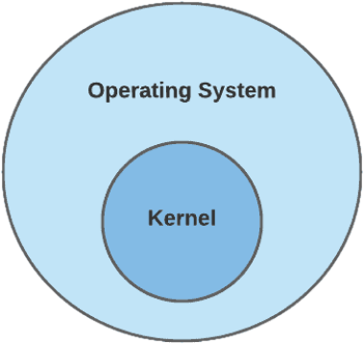


Java 17
SYNCHRONIZED

Slide 13
Java 17
SYNCHRONIZED WITH POLL

Slide 14
Java 17
ASYNCHRONIZED

Slide 15

Java 17
SYNCHRONIZED
ASYNCHRONIZED
👍
Programmers know the approach well
👎
Spends resources on working with OS threads
👎
👍
Utilizes more computing resources
👎
👍
Easy to debug and profile
👍
👎

Slide 16

👍
👍
PROJECT LOOM
👍
👍
SYNCHRONIZED
ASYNCHRONIZED
👎
👍
Programmers know the approach well
👍
Spends resources on working with OS threads
👎
👎
Utilizes more computing resources
👍
👎
👍
Easy to debug and profile

Slide 17
Java 21
LOOM: VIRTUAL THREADS

Slide 18
Java 21
LOOM: VIRTUAL THREADS
[V]
[V]
[V]
[V]
[V]
[V]
[V]
[V]
[V]
Virtual threads
OS threads
[P]
[P]
[P]

Slide 19
Java 21
LOOM: VIRTUAL THREADS
[V]
[V]
[V]
[V]
[V]
[V]
[V]
[V]
[V]
[V]
[V]
[V]
Virtual threads
OS threads
[P]
[P]
[P]

Slide 20
[V]
Java 21
LOOM: VIRTUAL THREADS
[V]
[V]
[V]
[V]
[V]
[V]
[V]
[V]
[V]
[V]
Virtual threads
OS threads
[P]
[P]
[P]

Slide 21
[V]
Java 21
LOOM: VIRTUAL THREADS
[V]
[V]
[V]
[V]
[V]
[V]
Virtual threads
OS threads
[P]
[P]
[P]

Slide 22

[V]
Java 21
LOOM: VIRTUAL THREADS
[V]
[V]
[V]
[V]
[V]
[V]
[V]
[V]
[V]
[V]
Virtual threads
OS threads
[P]
[P]
[P]
[P]

Slide 23
🍃 Using virtual threads in Spring
Java 21 what’s new?
spring.threads.virtual.enabled=true
Notes:
https://spring.io/blog/2023/09/09/all-together-now-spring-boot-3-2-graalvm-native-images-java-21-and-virtual

Slide 24

Java 21 what’s new?
👥Pattern matching
📹Records
📹👥 JEP 440: Record patterns
Notes:
git checkout java21/record-patterns
JEP 440: https://openjdk.org/jeps/440

Slide 25


⚕️JEP 441: Pattern Matching for Switch
Java 21 what’s new?
return switch (cardPair) { case CardPair<Card>(PlayingCard f, PlayingCard s) -> { System.out.println("Playing cards! First one: " + f + " Second one: " + s); yield cardValue(f) + cardValue(s); } case CardPair<Card>(UnoCard f, UnoCard s) -> { System.out.println("Uno cards! First one: " + f + " Second one: " + s); yield cardValue(f) + cardValue(s); } default -> throw new IllegalArgumentException("Unknown card type: " + cardPair); };
Notes:
git checkout java21/switch-patterns
JEP: https://openjdk.org/jeps/441

Slide 26
📶JEP 431: Sequenced Collections
Java 21 what’s new?
Collection
Set
Queue
SortedSet
NavigableSet
LinkedHashSet
List
Dequeue
Notes:
git checkout java21/sequenced-collections
JEP: JEP 431: Sequenced Collections (openjdk.org)

Slide 27
📶JEP 431: Sequenced Collections
Java 21 what’s new?
Collection
SequencedCollection
Set
Queue
SequencedSet
SortedSet
NavigableSet
LinkedHashSet
List
Dequeue
Notes:
git checkout java21/sequenced-collections
JEP: JEP 431: Sequenced Collections (openjdk.org)

Slide 28
📶JEP 431: Sequenced Collections
Java 21 what’s new?
Map
SequencedMap
SortedMap
NavigableMap
LinkedHashMap
Notes:
git checkout java21/sequenced-collections
JEP: JEP 431: Sequenced Collections (openjdk.org)

Slide 29
🧹JEP 439: Generational ZGC
Java 21 what’s new?
public static void main(String[] args) { new Object(); }
👦
👴
Notes:
JEP: https://openjdk.org/jeps/439

Slide 30
🆕 methods
Java 21 what’s new?
Collections
newSequencedSetFromMap(SequencedMap map)
unmodifiableSequencedCollection(SequencedCollection c)
unmodifiableSequencedSet(SequencedSet c)
unmodifiableSequencedMap(SequencedMap c)

Slide 31
🆕 methods
Java 21 what’s new?
String
indexOf(String str, int beginIndex, int endIndex)
indexOf(char str, int beginIndex, int endIndex)
splitWithDelimeters(String regex, int limit)
StringBuilder
repeat(CharSequence cs, int count)
repeat(int codePoint, int count)

Slide 32
🆕 methods
Java 21 what’s new?
Character
isEmoji(int codePoint)
isEmojiComponent(int codePoint)
…
Math
clamp(long value, int min, int max)
…

Slide 33

⁉️Your questions (maybe) my answers
Java 21 what’s new?

Slide 34

📇Talk to me
Java 21 what’s new?
Notes:
https://www.linkedin.com/in/nik-ischenko/

Slide 35

🧑‍💻Review the code
Java 21 what’s new?
Notes:
https://github.com/NikIschenko/java21-blackjack

